Slide 1
CIEEE Meeting Report
Firmware Update for the Board

Slide 2
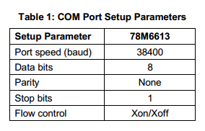
Steps to Program the Board
Using the USB controller on the board , connect it to the host PC.
Start the Hyper terminal application and create a session using the parameters given below.
The default firmware in the board is set to auto report.
It will report the Vrms, Irms, Power, PowerFactor and the Line frequency

Slide 3
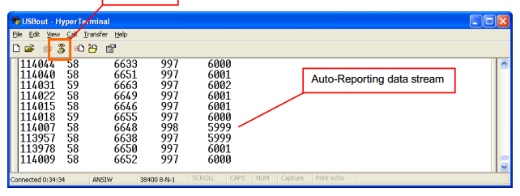
The output will look like this
This is when the board is connected to the 110V line.
Using CLI(Command line interface) we can create our own enhancements to suit our needs.
We can Refer to the 6613_PSU_S1_URT_V1_0 Firmware Description Document for a complete description of available CLI commands and their invocation usage.

